Slide 1
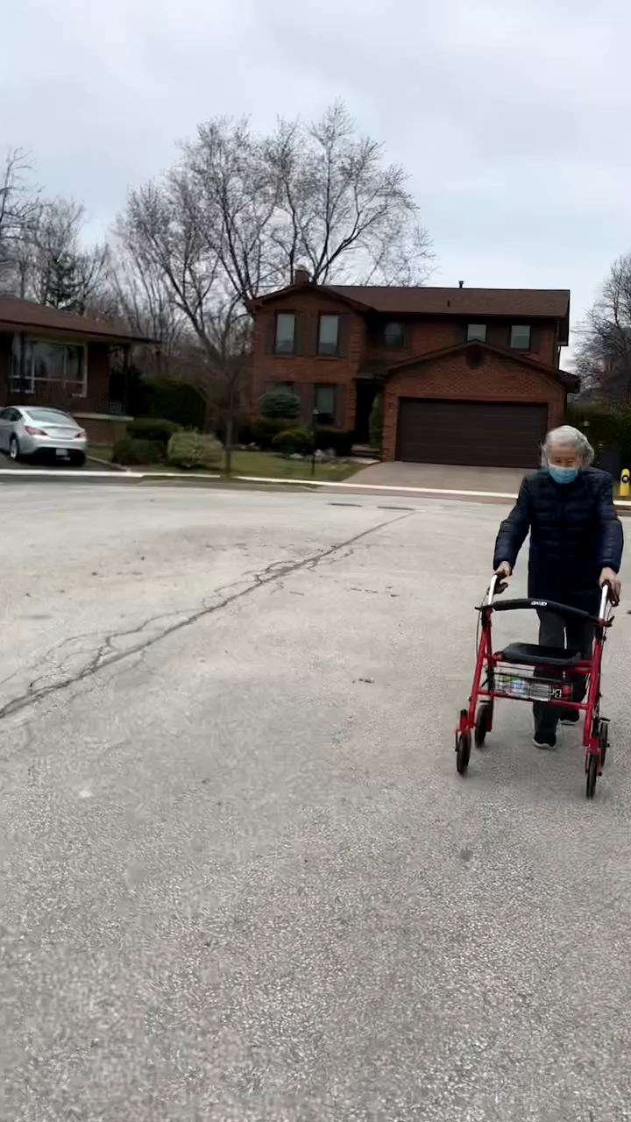

Mama’s Footsteps By Mei Lan Wang Zigzag Zigzag Mama's wobbly footsteps On the pavement that's recently rarely tread Left right Left right A villager's heart Quietly shining bright Neighbours' gardens Neighbour's driveways A grid of memories stretches in the company of little birdies' melodies Zigzag Zigzag Mama's weakening footsteps Trailing along the path that is on the other side of earth Far Far Far Far
www.eduorchids.com

