Slide 1
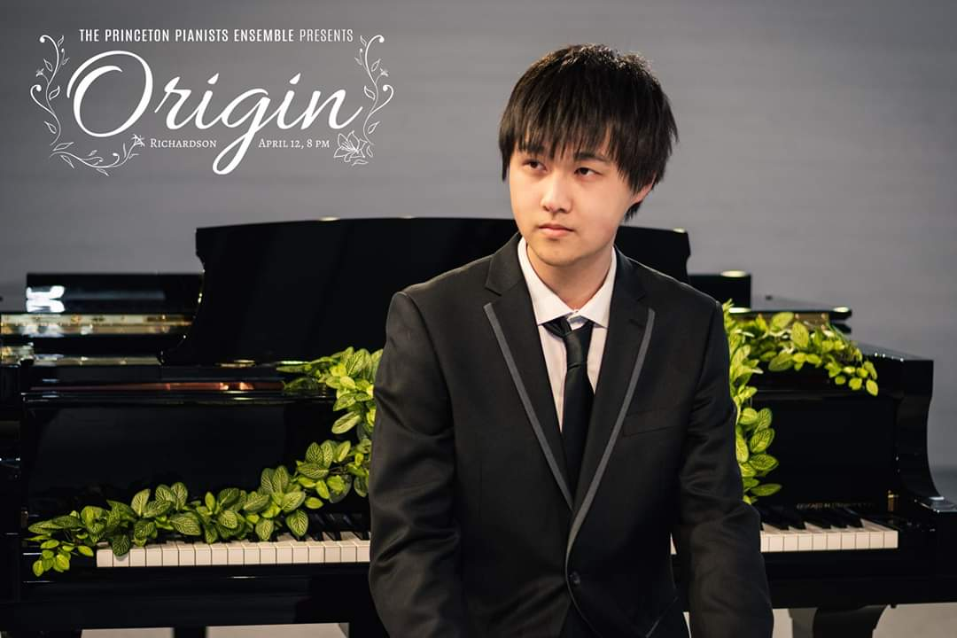
Edward Y. Zhang is a highly accomplished 2019 graduate from Princeton University, a member of The Phi Beta Kappa Society (the oldest and most prestigious academic honour society in U.S.A.). He obtained his Bachelor of Arts degree in Chemistry and a Certificate in Musical Performance. He is an active collaborative pianist who frequently performs with singers and string and wind players. He is a former music director of the Princeton Pianists Ensemble, a group that performs music on up to 5 pianos. He is also a composer, commissioned by the Princeton University Sinfonia in 2018. This coming September, Edward will begin his PhD program in Chemistry at Northwestern University in Evanston, Illinois.
ZhuoYue
One on One
Featuring
Edward Y. Zhang
EduOrchids Inc.

